Slide 1



DATA ENGINEERING PORTFOLIO PROJECT
Apache Airflow OMS
ETL Pipeline
A production-style, end-to-end Order Management System pipeline — extracting, validating, transforming, and warehousing data entirely with native Apache Airflow.
8
2,747
5
SOURCE TABLES
ROWS PROCESSED
BUILD PHASES
Mohamed Amer (Mo Amer)
Data Engineer · Designed & Built the Full Pipeline

Slide 2





PROJECT OVERVIEW
One Pipeline, Six Responsibilities
The objective was to build a production-style Airflow project — no dbt, no Great Expectations, no external transformation frameworks. Every stage of the ETL lifecycle, from raw Postgres extraction to warehouse-ready star schema, is implemented natively in Airflow.
AT A GLANCE
8
Source tables in oms_core
Extract
Validate
2,747
Pull all 8 OMS tables from Neon PostgreSQL
Row-count and null checks before every load
Total rows across all tables
6
Transform
Load
Clean types, fix data-quality issues, engineer metrics
Populate a warehouse-ready star schema
Warehouse tables (5 dims + 1 fact)
5
Aggregate
Notify
Build phases, fully delivered
Compute daily sales KPIs automatically
Email alerts the moment any task fails
APACHE AIRFLOW OMS PIPELINE
02

Slide 3


SYSTEM ARCHITECTURE
From Raw Postgres to Warehouse-Ready Star Schema
Every stage runs as an orchestrated Airflow task — no external tooling in the data path.
Neon
PostgreSQL
Airflow
Scheduler
Extract &
Validate
Transform
Load
Warehouse
Aggregate &
Notify
oms_core source
Dynamic DAG
PostgresHook, per-table
Clean, type-fix, engineer
Star schema upserts
KPIs + email alerts
Architecture mirrors the project spec: Neon PostgreSQL → Airflow Scheduler → Dynamic DAG → Extract → Validate → Transform → Load → Aggregate → Notify → UI / Logs.
APACHE AIRFLOW OMS PIPELINE
03

Slide 4






TECHNOLOGY STACK
Built on a Focused, Production-Grade Toolset
Apache Airflow
Neon PostgreSQL
Docker Compose
CeleryExecutor
Orchestration & scheduling
Source & warehouse database
Multi-service deployment
Distributed task execution
Redis
Python
Pandas
Pytest
Celery message broker
TaskFlow API & callables
Extraction & transformation
DAG integrity testing
APACHE AIRFLOW OMS PIPELINE
04

Slide 5
DELIVERY ROADMAP
Five Phases, Each Fully Delivered
PHASE 1
PHASE 3
PHASE 5
Foundations
ETL & Warehouse
Scale & Monitor
Docker Compose, LocalExecutor, TaskGroups, branching, retries
PostgresHook + SQL operators, validation, star schema load
CeleryExecutor, Redis, task duration analysis, worker scaling
1
2
3
4
5
PHASE 2
PHASE 4
Dynamic Pipelines
Production Hardening
XCom, Variables, TaskFlow API, Dynamic Task Mapping
Custom timetable, retry policy, failure callbacks, pytest
All five phases are complete and running in the current deployment.
APACHE AIRFLOW OMS PIPELINE
05

Slide 6


EXPLORATORY DATA ANALYSIS
A Clean Dataset — Three Fixes Still Required
Profiling all 8 tables (2,747 rows) up front — schema, types, nulls, duplicates — surfaced a near-perfect dataset with just one stray null, but three formatting issues that would have broken downstream analytics if left unfixed.
Dates read as plain text
A single NULL silently changed a data type
No per-line revenue metric
orderdate, hiredate, and date columns loaded as generic strings, blocking any time-series logic or filtering.
One NULL in employees.managerid (the CEO, who has no manager) forced pandas to upcast the whole ID column from integer to float.
orderitems stored quantity and unitprice separately with no combined total — every query would need to recompute it.
FIX Parsed explicitly with pd.to_datetime() into true datetime columns.
FIX Cast to pandas' nullable Int64 dtype — keeps IDs as clean integers.
FIX Engineered total_price = quantity × unitprice during transformation.
APACHE AIRFLOW OMS PIPELINE
06

Slide 7



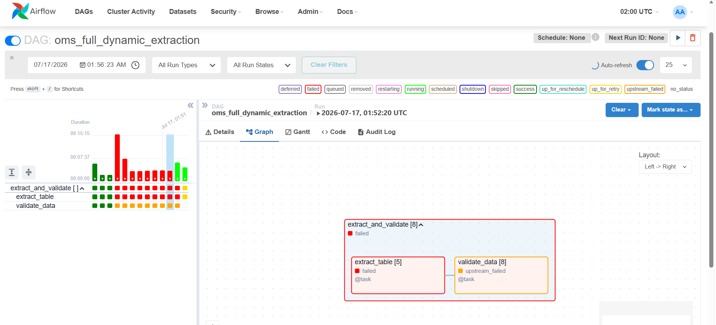
CASE STUDY · ROOT-CAUSE DEBUGGING
Diagnosing a Silent, Repeating Failure
STEP 1
STEP 2
STEP 3
STEP 4
Observe
Diagnose
Root Cause
Fix & Verify
4 of 8 extraction tasks failed — but the same four, every single run, across every retry.
A constant pattern rules out infrastructure: a pool or connection issue would fail randomly, not the same tables each time.
Queries omitted the schema name. Postgres silently searched the default public schema instead of oms_core.
Added an explicit oms_core. prefix to every query — all 8 tables extracted cleanly on the next run.
airflow · oms_full_dynamic_extraction
Real evidence — map_index 1, 2, 6, 7 fail red on every run, while 0, 3, 4, 5 stay green. That consistency is what pointed away from infrastructure and toward a logic bug.
The fix: SELECT * FROM oms_core.{table} — one schema prefix, and every failing task turned green.
APACHE AIRFLOW OMS PIPELINE
07

Slide 8
CASE STUDY II · IDEMPOTENT LOADING
A Second Bug: Postgres Rejected the Upsert
STEP 1
STEP 2
STEP 3
STEP 4
Error
Diagnose
Root Cause
Fix & Verify
Loading fact_sales threw a CardinalityViolation — Postgres refused the upsert outright.
The JOIN between stg_orders and stg_orderitems produced duplicate orderitemid rows within a single INSERT batch.
ON CONFLICT DO UPDATE cannot touch the same row twice in one statement — Postgres blocks it to protect consistency.
Added DISTINCT ON (orderitemid) to the SELECT, guaranteeing one row per key. Reruns are now fully idempotent.
psycopg2.errors.CardinalityViolation: ON CONFLICT DO UPDATE command cannot affect row a second time
Fixed with: SELECT DISTINCT ON (oi.orderitemid) ... ORDER BY oi.orderitemid
APACHE AIRFLOW OMS PIPELINE
08

Slide 9
DATA WAREHOUSE DESIGN
A Star Schema Built for Fast Analytics
Five dimensions surround one fact table — denormalized on purpose, so BI queries need minimal joins.
dim_product
productid · category · price
dim_customer
dim_store
customerid · name · email
storeid · city · state
fact_sales
orderitemid (PK) · quantity · unitprice · total_price
dim_employee
dim_date
employeeid · manager
datekey · weekday · weekend
orderitemid is used as the primary key — not (orderid, productid) — so multiple lines for the same product never collide.
APACHE AIRFLOW OMS PIPELINE
09

Slide 10



ENGINEERING FOR RESILIENCE
Built to Fail Small, Recover Fast
Dynamic Task Mapping
Bounded Connection Pooling
Each of the 8 tables runs as its own isolated task instance. One table failing retries alone — the other seven are untouched.
A dedicated 5-slot Airflow pool caps concurrent Neon connections, preventing extraction load from exhausting the database.
Idempotent by Design
Automatic Retries with Backoff
CREATE ... IF NOT EXISTS schema setup and ON CONFLICT upserts mean re-running the pipeline is always safe, never destructive.
Extraction tasks retry up to 5 times with a 2-minute delay, absorbing the transient network drops seen in early testing.
APACHE AIRFLOW OMS PIPELINE
10

Slide 11

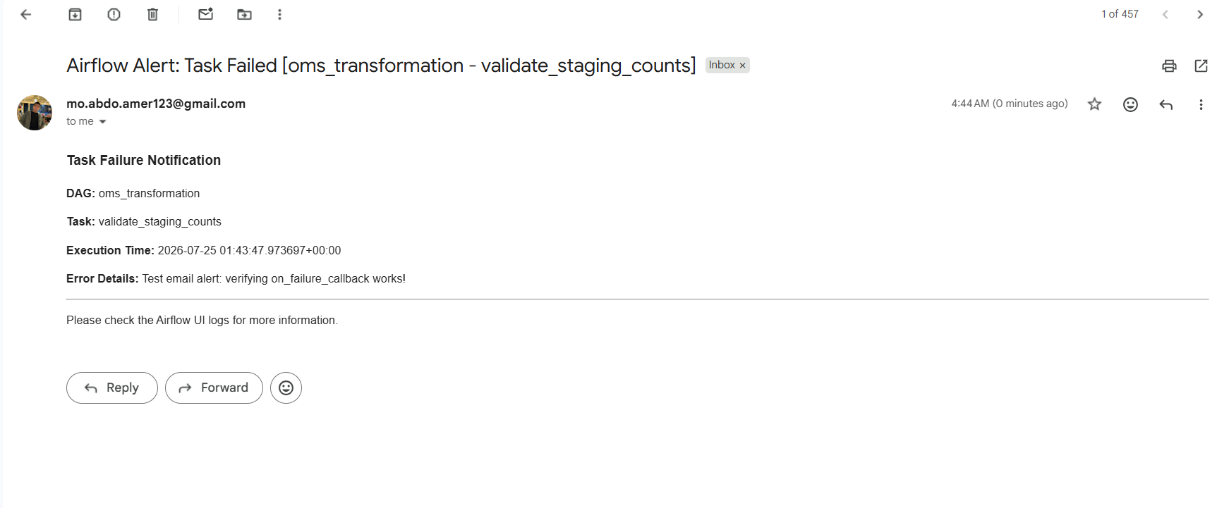
ORCHESTRATION, SCHEDULING & ALERTING
A Pipeline That Watches Itself
Custom Business-Days Timetable
CeleryExecutor + Redis
A custom Airflow Timetable plugin skips weekends automatically — the DAG only ever schedules on business days.
Tasks execute across dedicated worker processes via a Redis broker, decoupling scheduling from execution for real horizontal scale.
Instant Email Alerts
DAG Integrity Testing
An on_failure_callback sends a formatted SMTP email — DAG, task, timestamp, and error — the moment any task fails.
A pytest suite checks the DAG imports cleanly, has tasks, and contains no cyclical dependencies — before it ever reaches production.
inbox
Real evidence — the exact email delivered to the inbox when validate_staging_counts failed, generated automatically by the on_failure_callback — DAG, task, timestamp, and error, no manual checking required.
APACHE AIRFLOW OMS PIPELINE
11

Slide 12
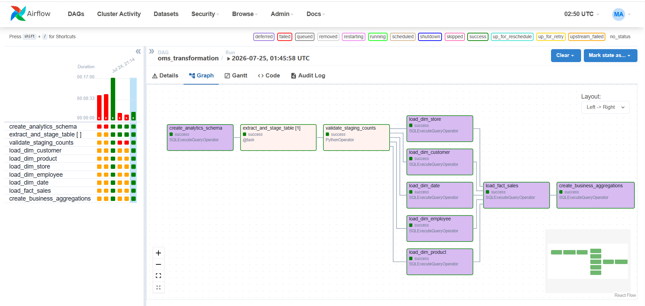
RESULTS
A Fully Green, Production-Ready Run
Every stage — schema setup, extraction, validation, all five dimensions, the fact table, and business aggregations — completes end to end.
12/12
8/8
6
100%
TASKS SUCCEEDED
TABLES EXTRACTED
WAREHOUSE TABLES LOADED
AUTOMATED, NO MANUAL STEPS
airflow · oms_transformation · 2026-07-25
APACHE AIRFLOW OMS PIPELINE
12

Slide 13


SKILLS DEMONSTRATED
What This Project Proves
End-to-end ETL pipeline design
Dynamic Task Mapping & the TaskFlow API
Data-quality diagnosis & root-cause debugging
Star schema data warehouse modeling
Docker, CeleryExecutor & distributed orchestration
Automated testing, alerting & monitoring
Mohamed Amer (Mo Amer)
Data Engineer · github.com · Built end-to-end on Apache Airflow
APACHE AIRFLOW OMS PIPELINE
13

